Slide 1
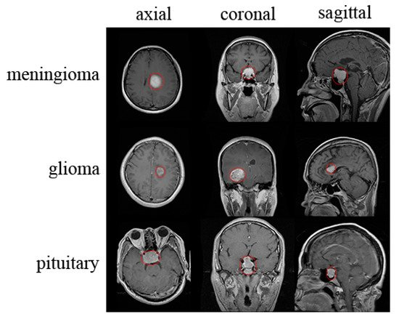
Brain Tumour Classification
Under the supervision of
Mrinmay Maharaj
Department of Computer Science
RKMVERI, Belur

Slide 2
Introduction
Radiology is a broad subject that needs more knowledge and understanding of medical science to identify tumors accurately. The need for a tumor detection program, thus, overcomes the lack of qualified radiologists. Using magnetic resonance imaging, biomedical image processing makes it easier to detect and locate brain tumors.
In this Project, a segmentation and detection method for brain tumors was developed using images from the MRI sequence as an input image to identify the tumor area. This process is difficult due to the wide variety of tumor tissues in the presence of different patients, and, in most cases, the similarity within normal tissues makes the task difficult. The main goal is to classify the brain in the presence of a brain tumor or a healthy brain.

Slide 3
Data Source and Description:
This dataset is a combination of the following three datasets available in kaggle:
figshare
SARTAJ dataset
Br35H
This dataset contains 7022 images of human brain MRI images which are classified into 4 classes: glioma - meningioma - no tumor and pituitary.
“No tumor” class images were taken from the Br35H dataset.

Slide 4
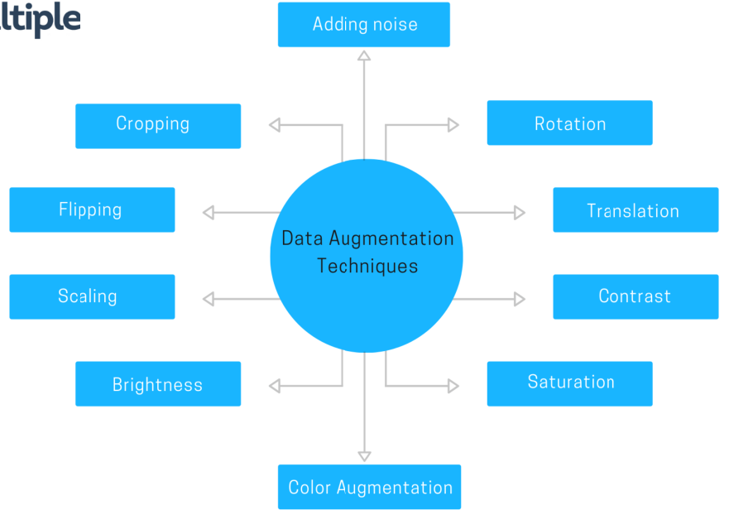
Data Augmentation:
Data augmentation is useful to improve performance and outcomes of machine learning models by forming new and different examples to train datasets. If the dataset in a machine learning model is rich and sufficient, the model performs better and more accurately.
I am using Vertical flip, Horizontal flip and some basic filter like colorJitter and some Sharpness enhancement for the augmentations.
Source

Slide 5
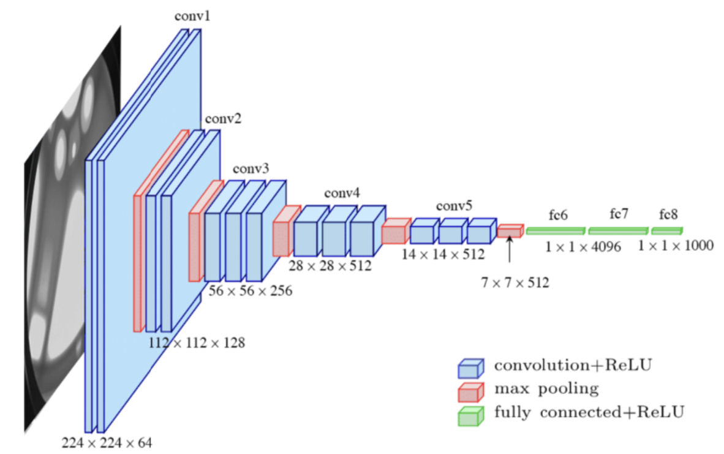
Baseline Model:
I have started with pretrained VGG16 model and implemented transfer learning techniques to update the weights of the model according to our data.
The VGG-16 architecture is able to classify 1000 different labels; we just need 4 instead. In order to do that we are going replace the last fully connected layer of the model with a new one with 4 output features instead of 1000.
Source

Slide 6
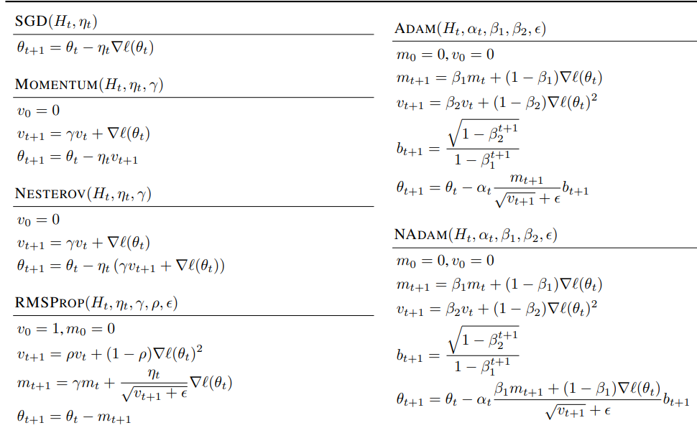
Experimenting with several Optimizers:
It is very important to select a good optimizer for our model during the training process, to make our predictions as correct as possible with a relatively smaller number of epochs.
I have implemented several optimizers and plot their loss and accuracy curves for both train and validation set for different initial learning rates.
Source

Slide 7
Experimenting with several Optimizers:
It is very important to select a good optimizer for our model during the training process, to make our predictions as correct as possible with a relatively smaller number of epochs.
I have implemented several optimizers and plot their loss and accuracy curves for both train and validation set for different initial learning rates.
Source

Slide 8
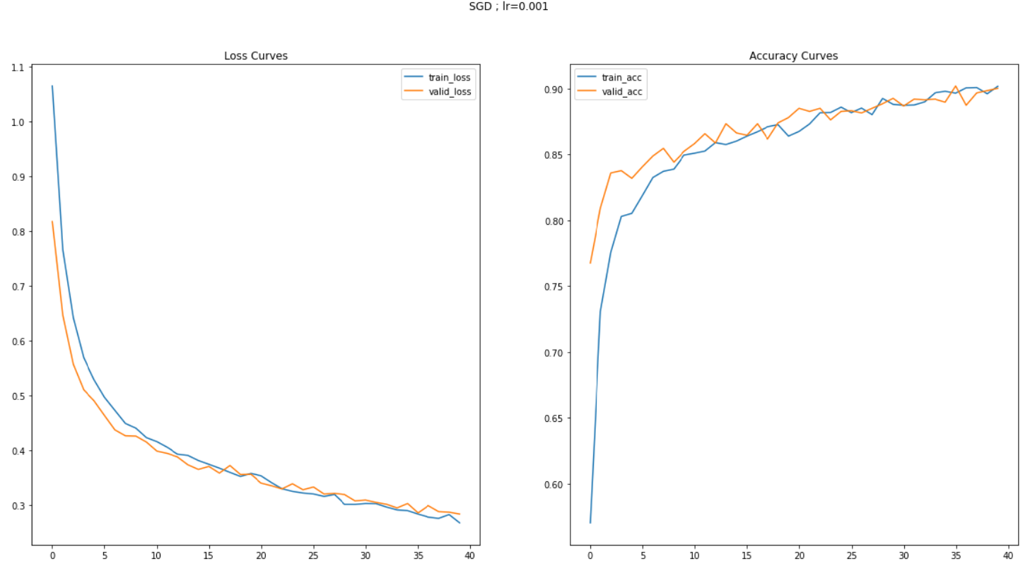
Loss and Accuracy curve for SGD with learning rate 0.001:

Slide 9
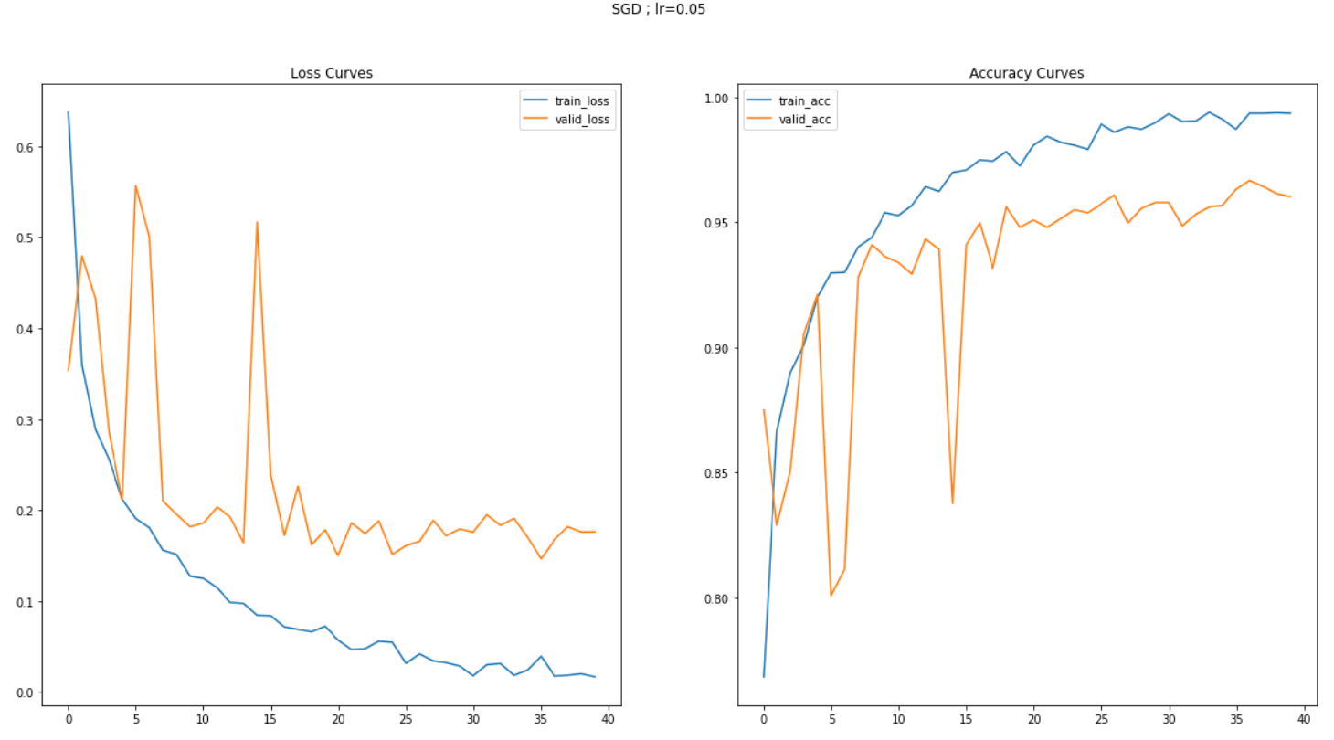
Loss and Accuracy curve for SGD with learning rate 0.05:

Slide 10
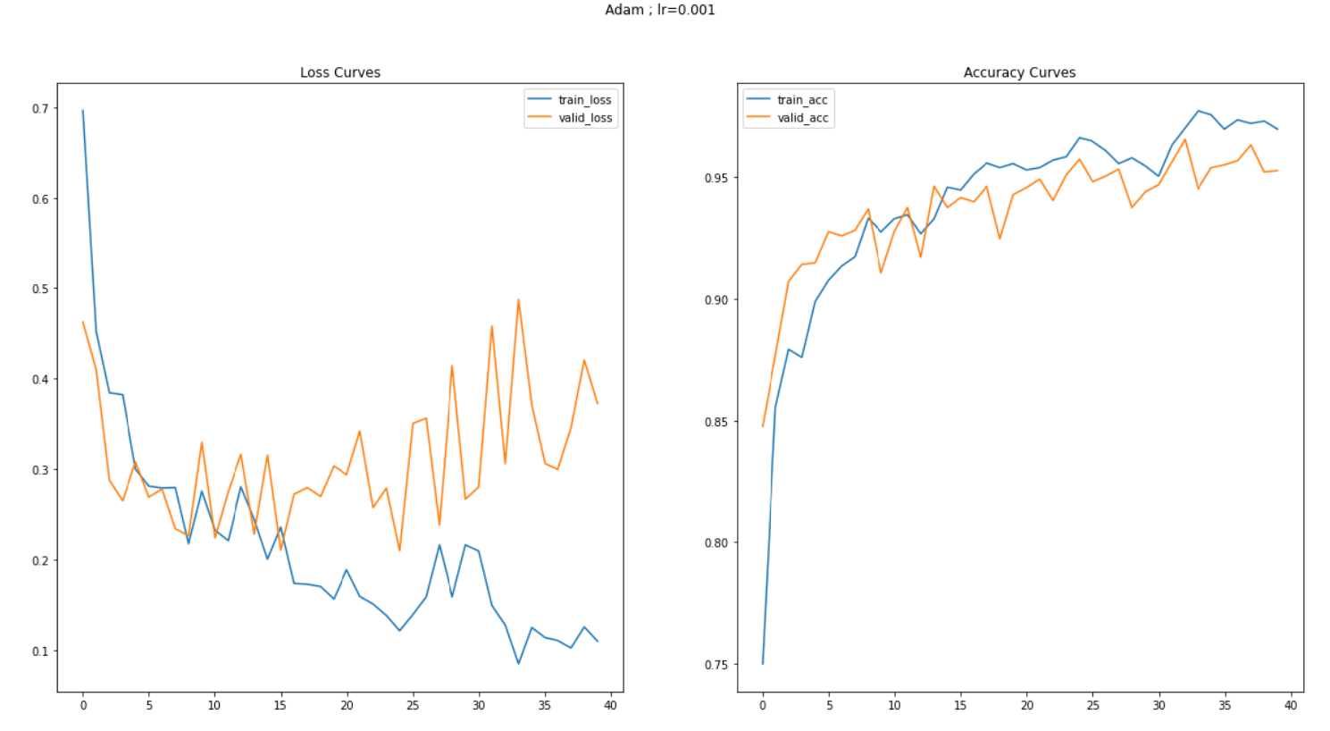
Loss and Accuracy curve for ADAM with learning rate 0.001:

Slide 11
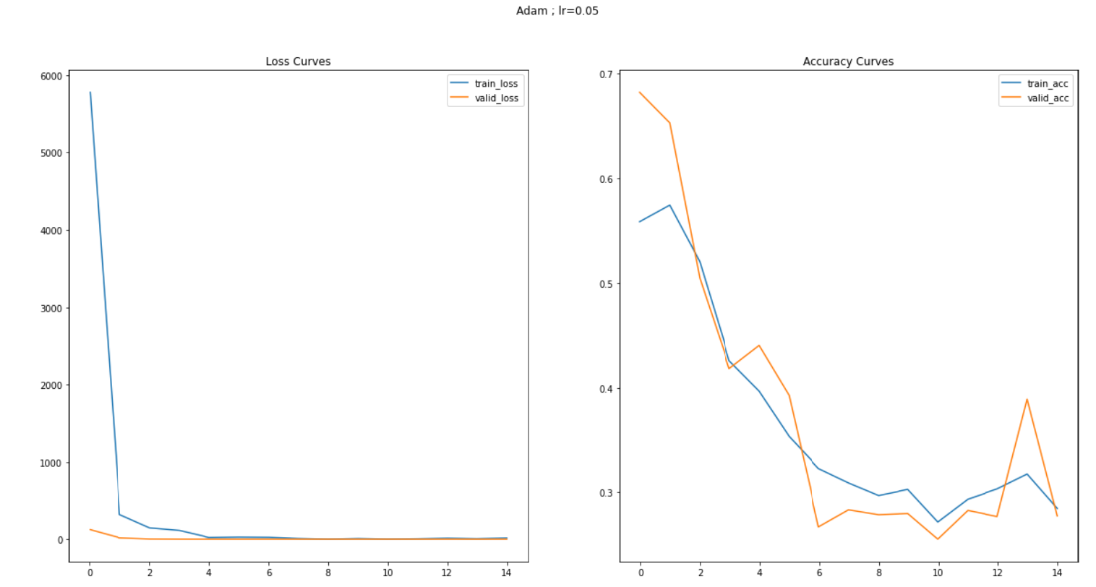
Loss and Accuracy curve for ADAM with learning rate 0.05:

Slide 12
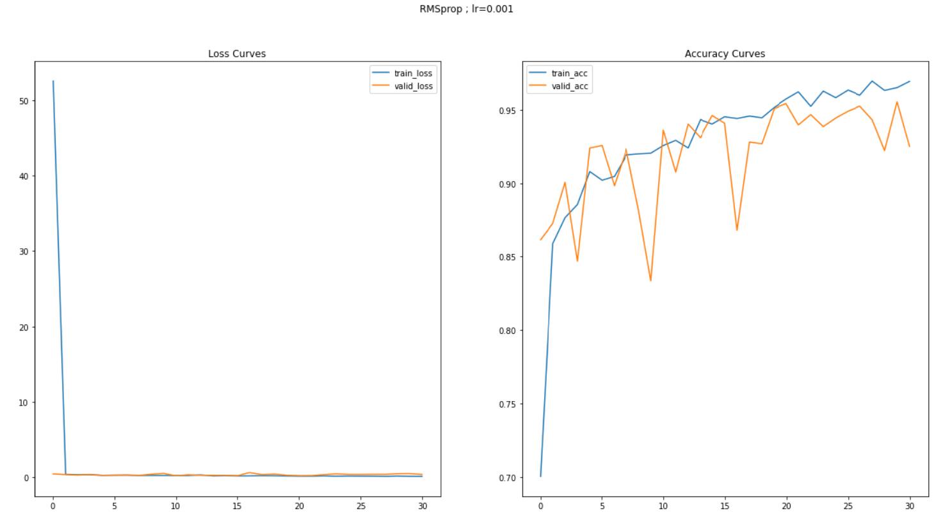
Loss & Accuracy curve for RMSprop with learning rate 0.001:

Slide 13
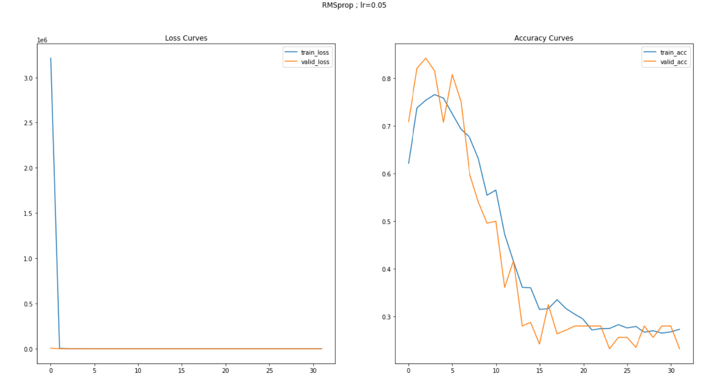
Loss & Accuracy curve for RMSprop with learning rate 0.05:

Slide 14
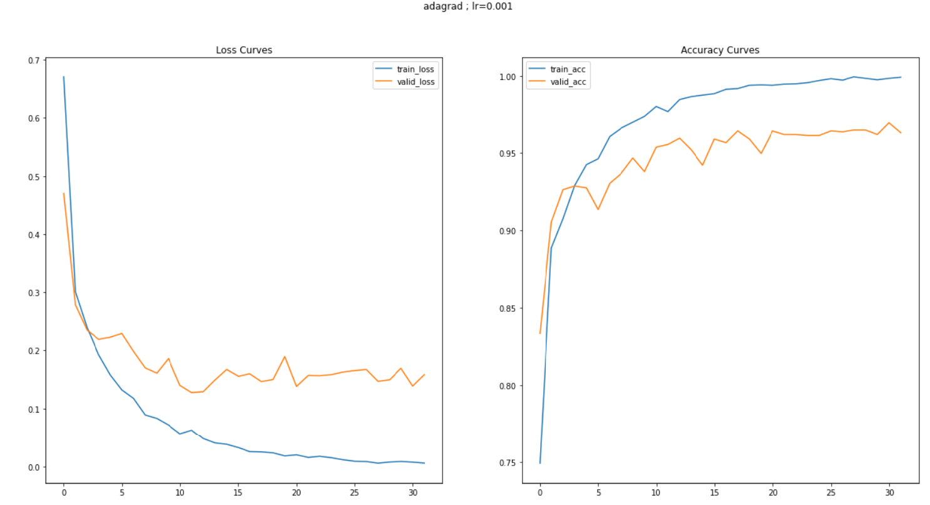
Loss & Accuracy curve for AdaGrad with learning rate 0.001:

Slide 15
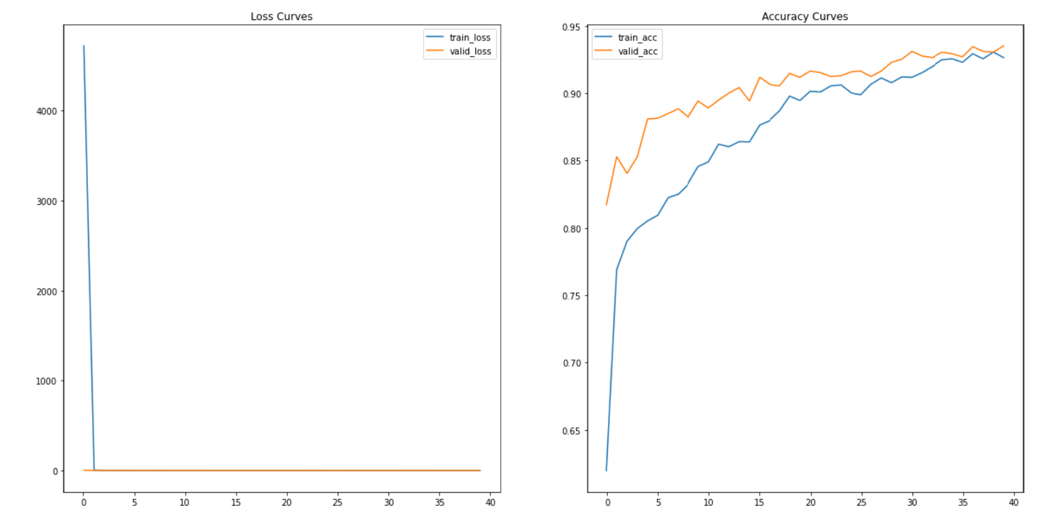
Loss & Accuracy curve for AdaGrad with learning rate 0.05:

Slide 16
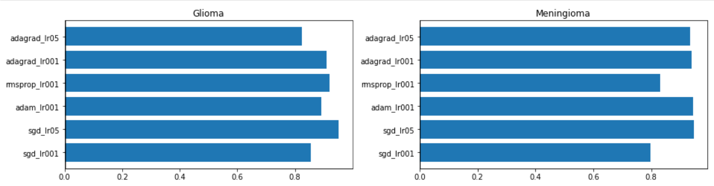
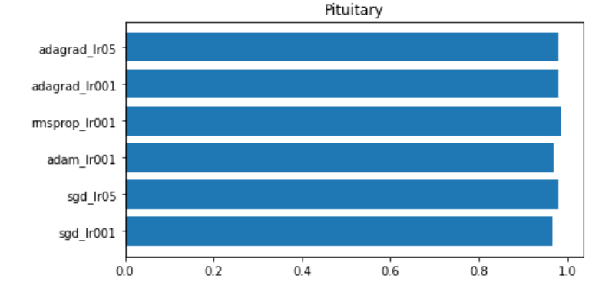
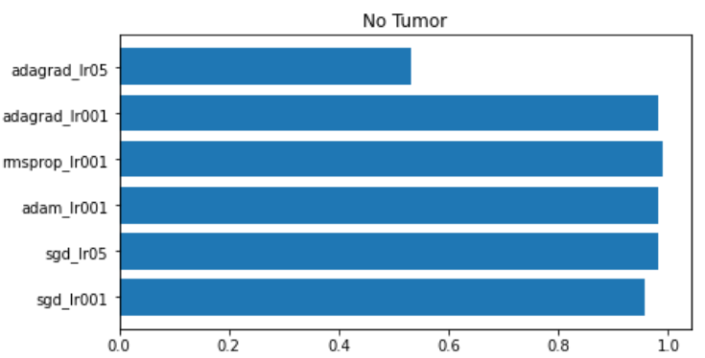
Overall accuracies of different optimizers for different classes:

Slide 17
Observation:
Choosing different optimizer helps to get more accuracy and faster convergence.
Starting with a higher learning rate in RMSprop and ADAM is a bad idea for our dataset as it decreases the accuracy tremendously.
From the graphs we conclude that the most stable optimization algorithms which is giving the highest average accuracy is ADAM with learning rate 0.001.

Slide 18
Creating the final Model:
To increase the accuracy and stability even more I have created a new architecture inspired by VGG-16.
I have applied batch normalization before feeding the values into the activation layer.
The dropout regularization is introduced inside the fully-connected VGG-16 layers.
This time I have used cross entropy as Loss function and ADAM as the optimizer with learning rate 0.001.

Slide 19
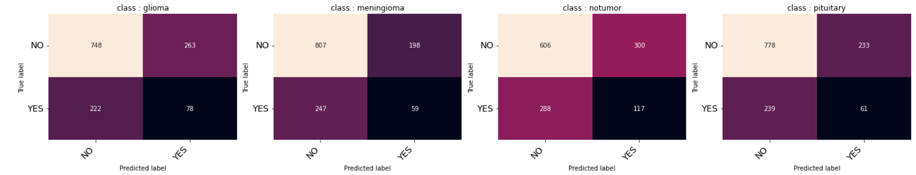
Evalution :
Our Training dataset is limited but it is giving an average of 98.08% percent accuracy after 40 epochs in training dataset and giving an average of 88.19% accuracy for the validation dataset.
For the test data the results have been shown by a confusion matrix:

Slide 20
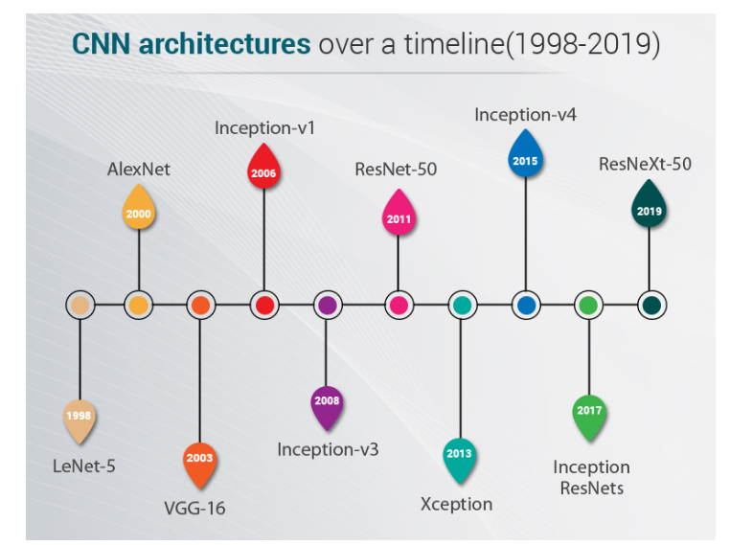
Future Work :
In this particular classification case the model that I have created is giving very good accuracy in spite of having very less amount of training data. In future I shall try to collect more Brain MRI scan data of such patients and again train the model.
Haven’t explore any other ML or DL models other than VGG16. I shall explore more such latest architectures.
Source

Slide 21
Reference :
A Comprehensive Guide on Deep Learning Optimizers.
VGG16-pytorch implementation on CIFAR10 dataset.
Don’t Use Dropout in Convolutional Networks.
A Gentle Introduction to Batch Normalization for Deep Neural Networks

Slide 22
Thank You
The End

